Slide 1
Predicting Lead Hazards in Chicago Residential Drinking Water
Valeria Balza
James Midkiff
Tarren Peterson

Slide 2
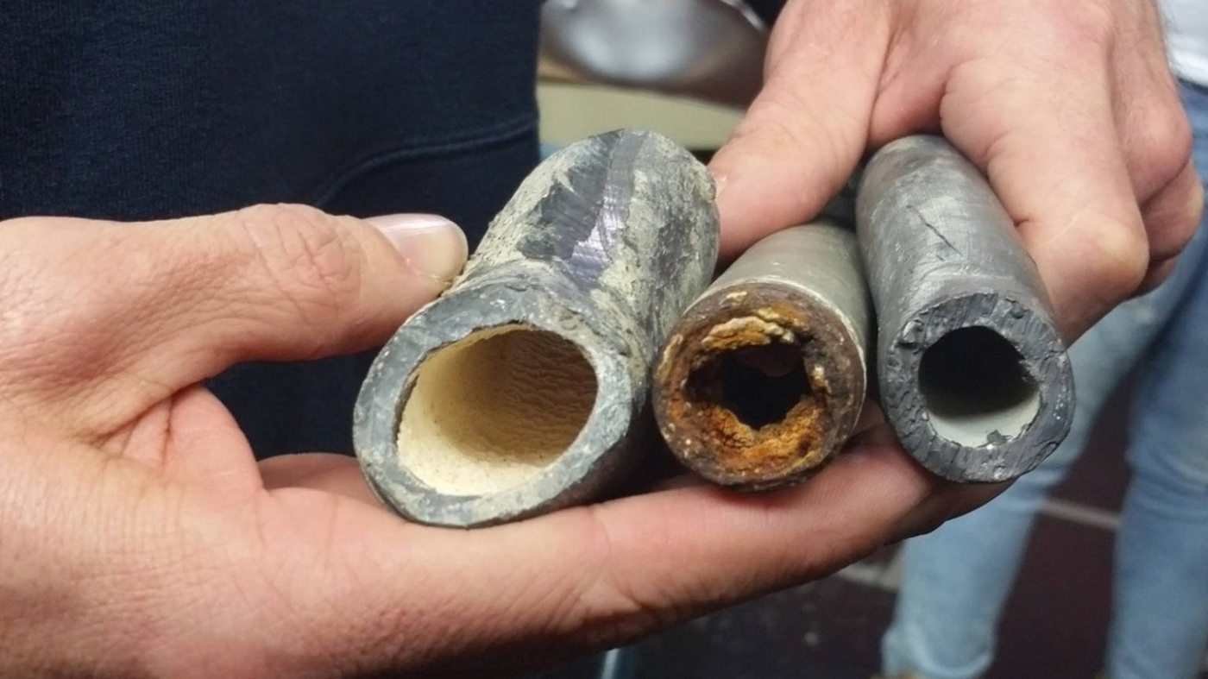

Slide 3


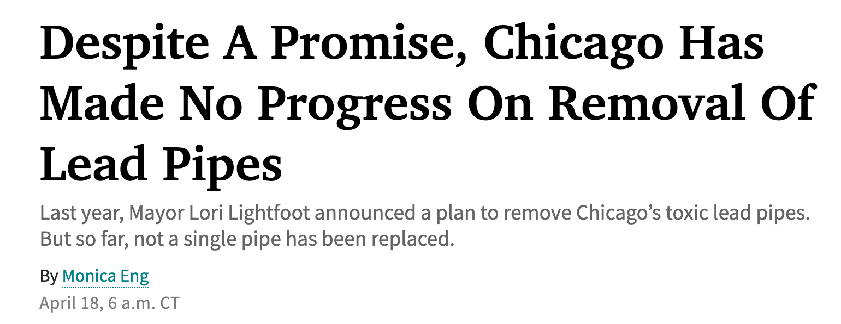

Issue Background
Notes:
Valeria - This slide will mirror the Background section in our paper, give information on the hazards of lead, prevalence of lead pipes in Chicago, Mayor’s initiative to replace lead pipes throughout the city

Slide 4

Water Data
Launched 2016, Dept. Water Quality
Non-Random Testing
Data Anonymization to Block Level
Thresholds:
High Lead Levels > 15 ppb
Medium Lead Levels > 5 ppb
Geocoding, aggregating to Block Group Level
Did any residence have any test have any sample result above threshold?
Notes:
James
Department of Water Quality
I discovered this dataset while going to test my own water.
Concern is service lines made of lead that connect a water main to a house. A service line is the homeowner’s responsibility
Three samples, upon opening tap, 2-3 minutes later, then 5 minutes later.
13XX East Hyde Park Blvd.
High Level:
Action level set by EPA
Medium Level:
FDA level set for bottled water
Recommended level by advocacy organizations
No known safe level of lead in water.

Slide 5
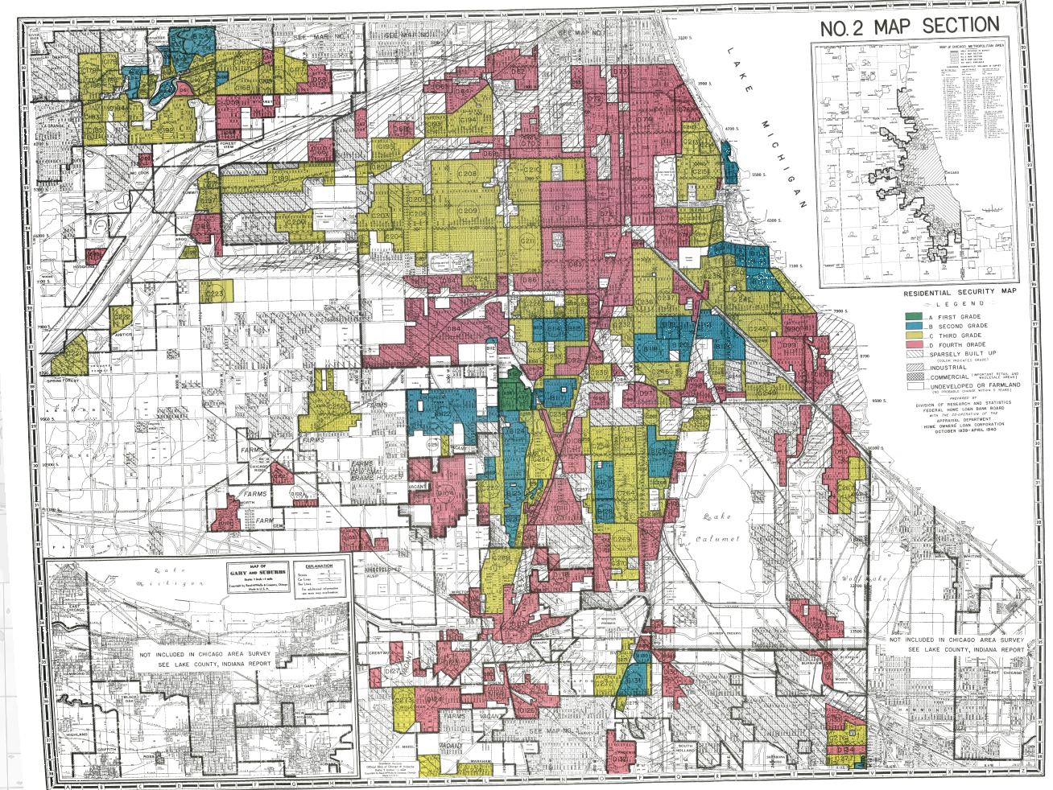
Socioeconomic Data
Variables gathered from the American Community Survey (2019):
Total Population
Median Income
Median Rent
% White
% Black
% Non-White
Number of Owner Occupied Housing Units
Redlined map of Chicago’s Southside, Richmond University Mapping Inequality Project
Notes:
We pulled socioeconomic data from the American Community Survey in the census in order to capture income, racial, and occupancy data
Chicago has a long history of racial inequity in housing, redlined map shown here led to subpar housing for many Chicagoans of color especially on the South and West Sides.
A study by the Metropolitan Planning Council found Illinoisans of color twice as likely to live in communities with lead pipes than their white counterparts
Income and Occupancy because we think variables like real estate prices, household income, and renter status might also be predictive

Slide 6
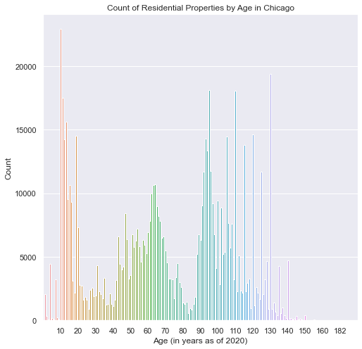
Residential Property Data
Variables selected from Cook County Property Assessment Data:
Total Properties
Property Class (zoning code)
Building Age - bunching
Land, Building Values
Land, Building Sizes
Wall Material
Roof Material
Housing Condition
Recently Renovated
Notes:
James
Cook County Residential Property Assessment Data
Law requiring lead pipes in Chicago until 1986
Theory is housing characteristics can be useful predictors more than area demographics alone, which could mask variation.
Does NOT include multifamily housing (7+ units)
One hot encoded categorical variables
Converted variables to proportions of residential housing within each block group.

Slide 7
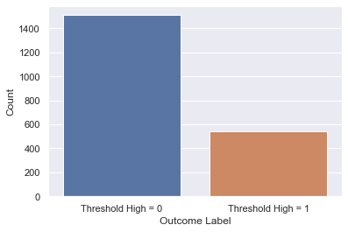
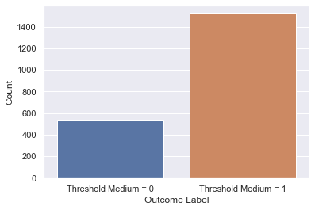
Imbalanced Sample
High Threshold Outcome Counts
Medium Threshold Outcome Counts
Notes:
Valeria - Discuss the unbalanced nature of our dataset for both high and medium threshold, emphasis on recall for each of our subsequent models to reduce false negatives (i.e. saying a block group doesn’t have lead pipes when it does)

Slide 8
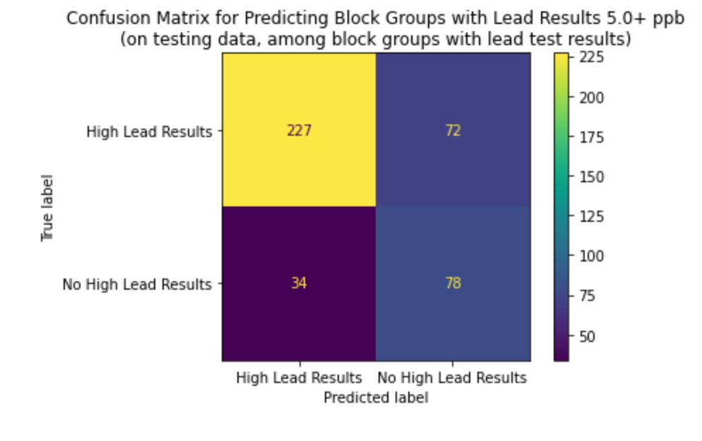
Linear SVC Models
Selected best models using recall
GridSearch over two models:
High (15.0+ ppb) vs. Not High
Medium (5.0+ ppb) vs. Not Medium
Most important features:
Total Population
Average Market Value of Building
Household Size
SVC Metrics | Recall | 0.65
 | Accuracy | 0.68
 | Precision | 0.43
Notes:
Valeria - discuss approach to SVC models and choose the best model. Then show feature importance and a confusion matrix for that model.

Slide 9
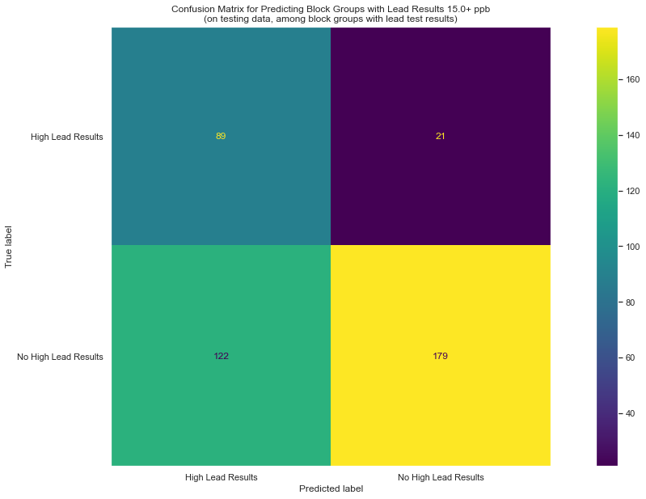
Random Forest Models
GridSearch over three models:
Random Forest
Weighted Random Forest
Random Forest with SMOTE
Most important features:
Owner Occupancy Rates
Older, Single Family Homes
Median Income
Weighted Random Forest Metrics | Recall | 0.7568
 | Accuracy | 0.6553
 | Precision | 0.4168
Notes:
Tarren - Discuss the approaches used for different random forest models including balanced and SMOTE. Add graphics from ‘best’ model including features importance and confusion matrix

Slide 10
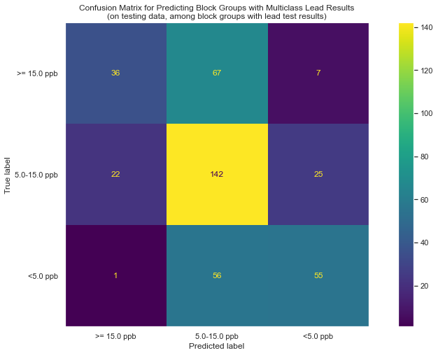
Logistic Models
GridSearch over three models:
High (15.0+ ppb) vs. Not High
Medium (5.0+ ppb) vs. Not Medium
Multinomial: High vs. Medium vs. Low
Good performance at identifying block groups with lead, less so for discerning severity of lead
Positive coefficients associated with single-family homes, negative coefficients with apartments
Multinomial Metrics | Recall | 0.5669
 | Accuracy | 0.5669
 | Precision | 0.5820
Notes:
James
Positive Features:
Certain property classes of single-family homes
Percentage of homes owner-occupied
Roofing type, shingles
Negative Features:
Building Size

Slide 11
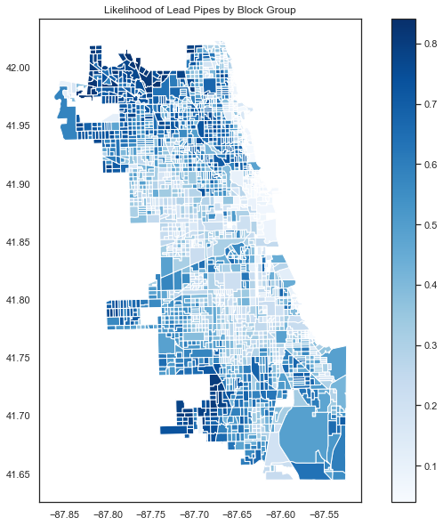
Policy Implications
There were some features that were consistently important across models
Owner Occupancy Rates
Single Family Homes
Income
A map of high lead risk emphasizes neighborhoods in the far North and South sides

Slide 12
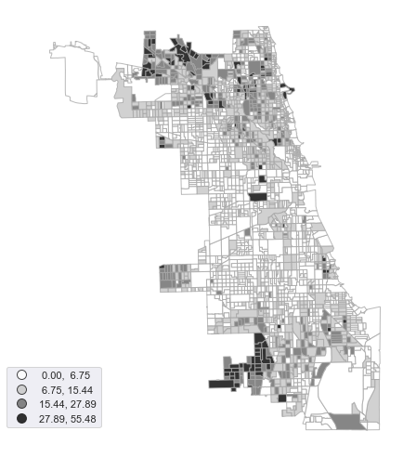
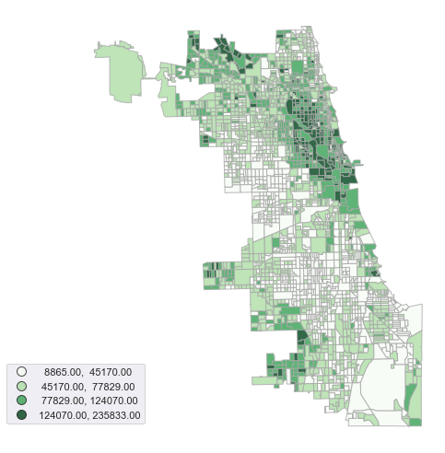
Ethical Implications / Further Work
Testing Density by Census Block Group
Median Income by Census Block Group
Notes:
The map in the previous slide showing our confidence levels on the presence of lead pipes looks very similar to the two maps shown here
First is testing density by census block group, second is Median Income by Census Block Group
If lead is endemic to Chicago as a whole, which might be possible given the law requiring lead pipes until 1986, our model could be predicting where tests took place, and it looks like tests are more likely in wealthy, homeowning areas
The city should invest in proactive testing in areas on the South and West sides that have had low testing to date. Once this data is gathered, the model can be rerun to better prioritize where to allocate pipe removal resources

Slide 13
Email Any Questions to:
vbalza@uchicago.edu
jmidkiff@uchicago.edu
tarren@uchicago.edu

